Slide 1
Solving simple linear equations with an additive step
Solving linear equations

Slide 2
how to use Oak lessons

Slide 3
I can solve a linear equation requiring a single additive step.

Slide 4
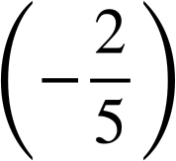
A solution to an equality with one variable is the value which, when substituted, maintains the equality between the expressions.
The additive inverse of a number is a number that, when added to the original number, gives the sum of 0
A number and its additive inverse make a zero pair.
Examples of zero pairs:
(−7) and 7
x and (−x)
0.3 and (−0.3)
and

Slide 5

Solving simple linear equations with an additive step
Additive steps using representations
Writing solutions algebraically

Slide 6
Additive steps using representations
An equation with an additive relationship can be represented with a bar model.
a + 6 = 20
6 = 20 − a
a = 20 − 6
a
6
20
What equations can you write from this bar model?
When there is only one variable it is possible to use a bar model to find the solution to the equation.
A solution to this equation will be a value for a which makes both sides of the equation equal.

Slide 7
Additive steps using representations
One of these equations makes it clear what the solution is. Which one?
a + 6 = 20
6 = 20 − a
a = 20 − 6
a
6
20
All we need to do is calculate 20 − 6 and this will give the solution to the equation.
The solution to all these equations is when a is 14

Slide 8
Additive steps using representations
a + 6 = 20
6 = 20 − a
a = 20 − 6
a
6
20
The solution to all these equations is when a is 14
We can substitute 14 for a in each equation to check this is the solution.
(14) = 20 − 6
14 = 14
(14) + 6 = 20
20 = 20
6 = 20 − (14)
6 = 6

Slide 9
Additive steps using representations
a
a
6
−6
a + 6 = 20
−6
20
14
What operation have we done to both bars to get the value 14?
Add −6

Slide 10
Additive steps using representations
What equations can you write for this bar model?
(23) − 3 = 20
20 = 20
p = 20 + 3
p − 3 = 20
p − 20 = 3
p
20
3
(23) − 20 = 3
3 = 3
Which equation makes it clear what the solution is?
p = 20 + 3
p = 23
The solution to this equation is when p is 23
We can check this works for the other equations.

Slide 11
Additive steps using representations
p
p = 20 + 3
20
3
What made this solution even easier to find than the previous two?
The bar representing p is ‘on its own’ we do not need to rearrange the equation or apply an operation to the top bar to isolate p
The process of finding a solution for an equation is called solving.
When solving an equation we are looking for the value of the unknown.
To do this we need to isolate the unknown to see its value ‘on its own’.

Slide 12
Additive steps using representations
Which of the equations below are represented by this bar model?
r
12
31 = 12 − r
31
r = 31 − 12
31 = 12 + r
31 = r − 12
r = 31 + 12
31 − 12 = r
r + 31 = 12
31 − r = 12
r + 12 = 31
What is the solution to those equations, how do you know?
r = 31 − 12
r = 19
Solution to this equation is when r is 19

Slide 13
Additive steps using representations
What equation is represented by this balance scale?
x + 3 = 5
1
1
1
What have I done to the left scale pan?
x
1
1
1
1
1
Added 1
What would we need to do to the right hand side to balance the scales?
1
1
1
1
1
Add 1
x
1
1
1
1
1
We have added the same amount to both sides so we have maintained equality.

Slide 14
Additive steps using representations
This time I have added −1
What will happen to the left hand side?
−1
1 and −1 are zero pairs because they add to 0 The −1 and one of the 1 tiles will cancel out.
−1
1
1
1
x
1
1
1
1
1
Adding −1 is the same as subtracting 1
What do we need to do to the right hand side to maintain equality?
1
x
1
1
1
1
1
What is our new equation?
x + 2 = 4

Slide 15
Additive steps using representations
What have I done to the equation x + 3 = 5 in these 2 examples?
−1
−1
Added −3
−1
−1
−1
1
−1
1
1
x
1
1
1
1
1
x
1
1
1
Added 3
1
1
1
1
1
1
1
1
x
1
1
1
1
1

Slide 16
Additive steps using representations
Looking at all 4 examples, which was the most useful operation for finding the solution to x + 3 = 5
Add 1
Add −3
1
1
1
1
1
x
1
1
1
1
1
x
1
1
Add −1
1
Add 3
1
1
1
1
1
1
1
1
1
x
1
1
1
1
1
x
1
1
1
1
1

Slide 17
Additive steps using representations
Adding −3 was the most useful option to find the solution as it has isolated x
1
1
1
x
1
1
1
1
1
Add −3
The solution to the equation x + 3 = 5 is now clearly when x is 2
x
1
1

Slide 18
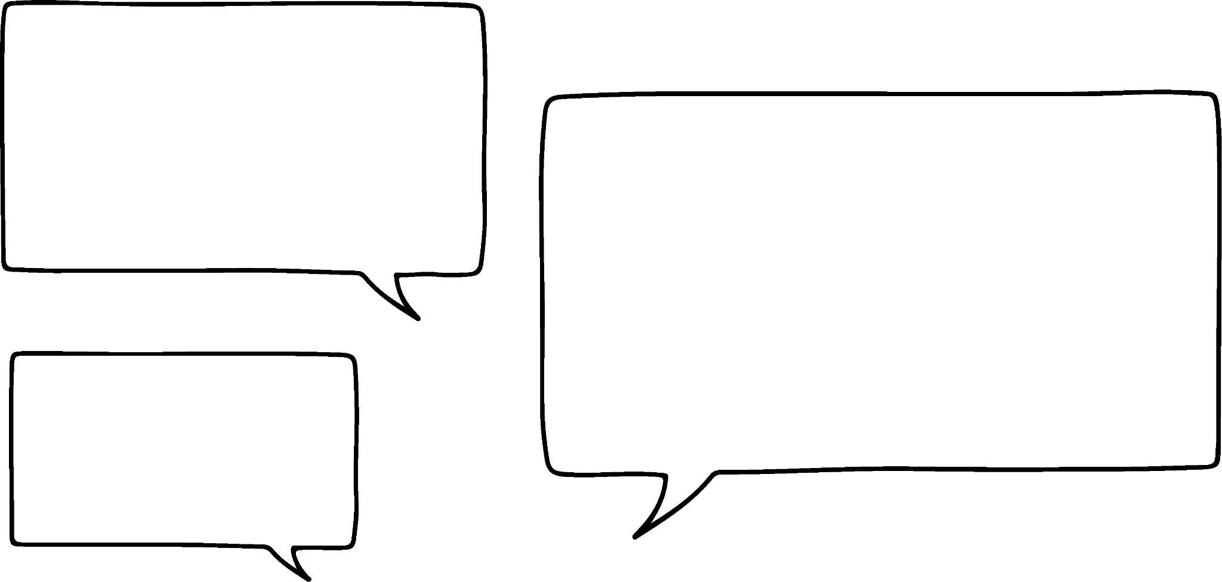



Additive steps using representations
Some pupils are trying to solve the equation represented on this balance.
I’m going to add 3
x
7
16
x
Sam
I’m going to add −x
Will any of these options isolate x ?
Jacob
I’m going to add −7
Sofia

Slide 19
Additive steps using representations
Some pupils are trying to solve the equation represented on this balance.
I’m going to add 3
x
7
3
16
3
x
Sam
I’m going to add −x
x
Jacob
10
19
x
I’m going to add −7
Sofia
Sam’s choice does not.

Slide 20
Additive steps using representations
Some pupils are trying to solve the equation represented on this balance.
I’m going to add 3
−x
−x
x
7
16
x
Sam
I’m going to add −x
−x
Jacob
7
16
x
I’m going to add −7
Sofia
Jacob’s choice does not.

Slide 21
Additive steps using representations
Some pupils are trying to solve the equation represented on this balance.
I’m going to add 3
−7
−7
x
7
16
x
Sam
I’m going to add −x
x
Jacob
9
x
I’m going to add −7
Sofia’s choice does not.
Whilst we have maintained equality by adding the same thing to both sides, none of these options have isolated x
Sofia

Slide 22
Additive steps using representations
Some pupils are trying to solve the equation represented on this balance.
−x
What about if I combine my idea with Jacob’s and also add −x ?
−x
x
9
x
Sofia
Although this looks like we’ve isolated x, the right hand side still has an x term (9 − x) So this does not give us the solution for one positive x
This is an example of an equation where we cannot isolate x just with an additive step.
−x
9
x

Slide 23
Additive steps using representations
What operation will isolate x? Choose from the options to the right.
+ 4
5
+ 1
1
1
x
1
1
1
1
10
x
+ (−1)
+ (−10)
+ 10
+ 9
+ (−5)
1
1
1
1
1
1
9
+ (−9)
1
1
1
1
1
1
x
1
x
10
+ 5
+ (−4)

Slide 24
Additive steps using representations
What operation will isolate x? Choose from the options to the right.
+ 4
5
+ 1
1
1
x
1
1
1
1
10
x
+ (−10)
+ (−1)
+ (−5)
+ 10
+ 9
1
1
1
1
1
1
9
1
1
1
1
1
1
x
1
x
10
+ 5
+ (−4)
+ (−9)

Slide 25
Additive steps using representations
1) Find the value of the unknown in each bar model. Explain how you know.
a)
15
c)
c
a
9
27
31
b)
b
33
d)
8.4
41
d
5.7

Slide 26
Additive steps using representations
2) Complete the balance scales to show the additive step needed to find the solution. What is the solution for each equation?
a)
b)
c)
19
8
2
7
11
30
x
x
x
−2
2
7
11
30
x
x
x
x

Slide 27
Additive steps using representations
1) Find the value of the unknown in each bar model. Explain how you know.
a)
15
c)
c
a
9
27
31
This represents the equation: 15 − 9 = a
6 = a solution when a is 6
This represents the equation: c = 27 + 31
c = 58 solution when c is 58
b)
b
33
d)
8.4
41
d
5.7
This represents the equation: b = 41 − 33
b = 8 solution when b is 8
This represents the equation: 8.4 − 5.7 = d
2.7 = d solution when d is 2.7

Slide 28
Additive steps using representations
2) Complete the balance scales to show the additive step needed to find the solution. What is the solution for each equation?
a)
b)
c)
19
8
2
7
11
30
x
x
x
−8
−11
−11
−2
−2
19
8
−8
2
7
11
30
x
x
x
11
x
5
19
x
x
solution when x is 5
solution when x is 19
solution when x is 11

Slide 29
Solving simple linear equations with an additive step
Additive steps using representations
Writing solutions algebraically

Slide 30
Writing solutions algebraically
We can use the same method with equations without representations.
Solve the equation x + 17 = 53
x + 17 | = | 53
x + 17 + (−17) | = | 53 + (−17)
x | = | 36
x + 17 | = | 53
x + 17 + (−17) | = | 53 + (−17)
x + 17 | = | 53
The additive inverse of + 17 is + (−17)
17 + (−17) = 0 because they are the additive inverse of each other.
When we solve an equation, we write our working down the page.
Each equivalent equation goes on a new line.
We have shown that we have maintained equality by adding the same value to both sides.

Slide 31



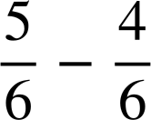

Writing solutions algebraically
How could we solve this equation?
How could we solve this equation?
y + 0.7 | = | 6.5
y + 0.7 + (−0.7) | = | 6.5 + (−0.7)
y | = | 5.8
x +..... | =
y + 0.7 | = | 6.5
y + 0.7 + (−0.7) | = | 6.5 + (−0.7)
y + 0.7 | = | 6.5
x + + ( ) | = | + ( )
x | =
The additive inverse of + 0.7 is + (−0.7)
x | =
It may help to convert the fractions so they have a common denominator.

Slide 32
Writing solutions algebraically
Solve the equation x − 18 = −10
Solve the equation x − 21 = −6
x − 18 | = | −10
x − 18 + (18) | = | −10 + (18)
x | = | 8
x − 18 | = | −10
x − 18 + (18) | = | −10 + (18)
x − 18 | = | −10
x − 21 | = | −6
x − 21 + (21) | = | −6 + (21)
x | = | 15
x − 21 | = | −6
x − 21 + (21) | = | −6 + (21)
x − 21 | = | −6
We can check by substituting
Check your answer.
(8) − 18 | = | −10
−10 | = | −10
(8) − 18 | = | −10
(15) − 21 | = | −6
−6 | = | −6
(15) − 21 | = | −6
So the solution is when x = 8
So the solution is when x = 15

Slide 33

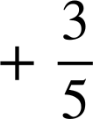
Writing solutions algebraically
What is the additive inverse for each of these?
+ 3.4
−3.4
− 0.5
+ 0.5
+ 1
−1

Slide 34

Writing solutions algebraically
Which of these is the solution to x + 6 = −10 ? How do you know?
4
x + 6 | = | −10
x + 6 + (−6) | = | −10 + (−6)
x | = | −16
−4
Or you could check by substitution
(-16) + 6 = −10
−10 = −10
16
−16

Slide 35
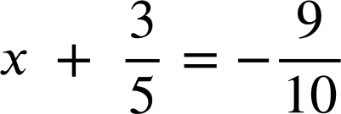
Writing solutions algebraically
Solve the following equations.
a)
d)
x + 1 | = | 12
x + 13 | = | 11
x + 3.6 | = | 17.8
x − 10 | = | −8.4
b)
e)
x − 18 | = | 42
c)
f)

Slide 36
Writing solutions algebraically
2) Spot the mistakes in the following methods to solve these equations.
x + 7 | = | −3
x + 7 + (7) | = | −3 + (7)
x | = | 4
x − 5 | = | 10
x − 5 + 10 | = | 10 + 10
x + 5 | = | 20
a)
c)
x + 7.1 | = | 23.5
x + 7.1 + (−7.1) | = | 23.5
x | = | 23.5
x − 23 | = | 23
x − 23 + (23) | = | 23 − 23
x | = | 0
b)
d)

Slide 37
Writing solutions algebraically
Solve the following equations.
a)
d)
x + 1 | = | 12
x + 1 + (−1) | = | 12 + (−1)
x | = | 11
x + 13 | = | 11
x + 13 + (−13) | = | 11 + (−13)
x | = | −2
x + 3.6 | = | 17.8
x + 3.6 + (−3.6) | = | 17.8 + (−3.6)
x | = | 14.2
x − 10 | = | −8.4
x − 10 + 10 | = | −8.4 + 10
x | = | 1.6
b)
e)
x − 18 | = | 42
x − 18 + 18 | = | 42 + 18
x | = | 60
c)

Slide 38




Writing solutions algebraically
Solve the following equations.
f)

Slide 39
Writing solutions algebraically
2) Spot the mistakes in the following methods to solve these equations.
x + 7 | = | −3
x + 7 + (7) | = | −3 + (7)
x | = | 4
x − 5 | = | 10
x − 5 + 10 | = | 10 + 10
x + 5 | = | 20
a)
c)
Should have added −7 not 7 x = −10
Hasn’t isolated x, could now add −5 to both sides x = 15
x + 7.1 | = | 23.5
x + 7.1 + (−7.1) | = | 23.5
x | = | 23.5
x − 23 | = | 23
x − 23 + (23) | = | 23 − 23
x | = | 0
b)
d)
Subtracted 23 instead of added 23 to RHS x = 46
Forgot to add −7.1 to RHS x = 16.4

Slide 40
Solving simple linear equations with an additive step
Equations with a single additive step can be solved with a bar model.
Equations with a single additive step can be represented with a balance and solved by maintaining equality.
This method and solution can be written algebraically.
To isolate x and solve, the additive inverse of the constant must be added to both sides of the equation.

Slide 41

© Oak National Academy 2023.
Produced in partnership with Mathematics in Education and Industry.
Licensed on the Open Government Licence v3.0, except where otherwise stated. See Oak terms and conditions.

